Slide 1

CredSSP encryption oracle remediation fix
QuickTip

Slide 2
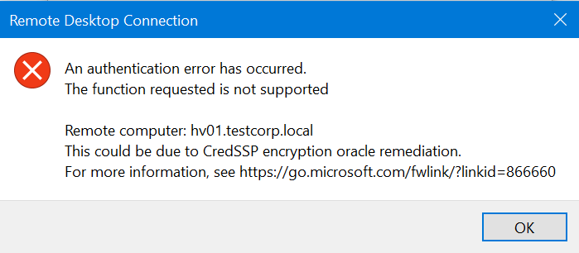
Intro
This fix applies to the scenario in which you want to make a RDP connection to another computer and get the following:

Slide 3
Context
In 2018 a vulnerability was discovered in CredSSP that could allow remote code execution
Since RDP was one of the affected items by this vulnerability, Microsoft issued a security update for it
In order for RDP to continue working the update has to be installed on both clients and servers

Slide 4
Affected OS versions
If your client/server has one of the following OS versions you will need the appropriate patch for your OS:
Windows 7/Windows Server 2008 R2
Windows 8/Windows Server 2012
Windows 8.1/Windows Server 2012 R2
Windows Server 2016
Windows 10 1709 and older

Slide 5
Get the update
Use this site to get the update for your version of Operating System:
https://support.microsoft.com/en-us/help/4295591/credssp-encryption-oracle-remediation-error-when-to-rdp-to-azure-vm

Slide 6
https://www.youtube.com/channel/UCcZ-jLbPwNr8E_v9-65n8Iw https://github.com/itknowledge4

